Slide 1
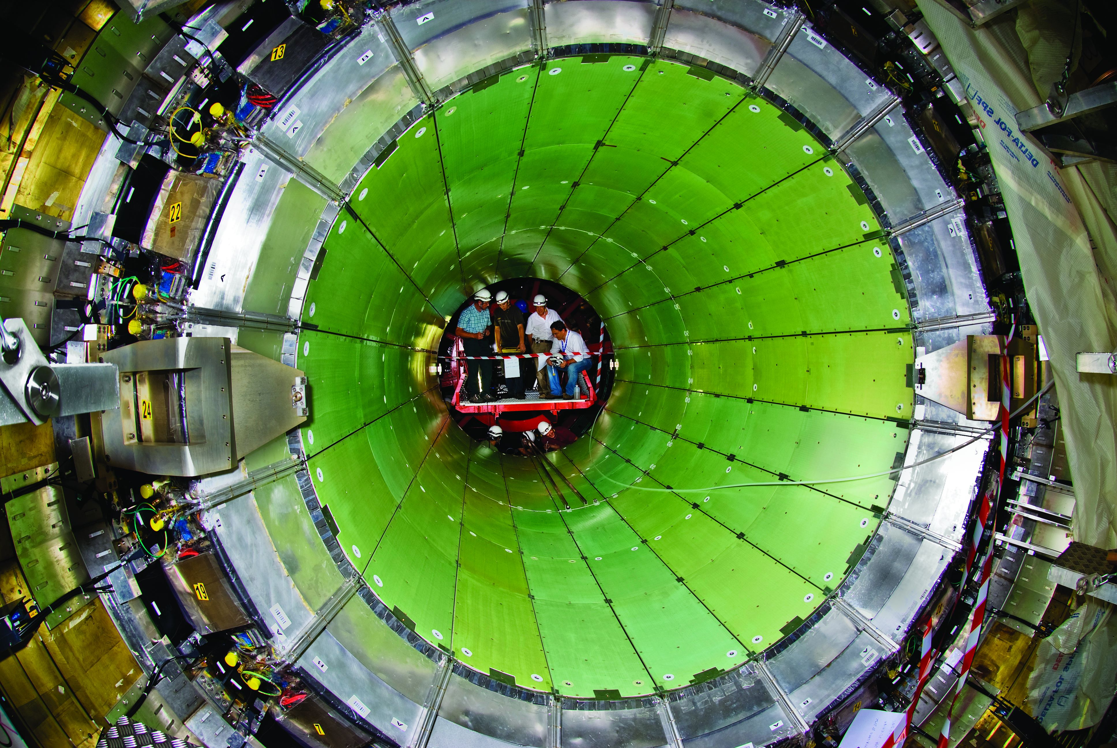
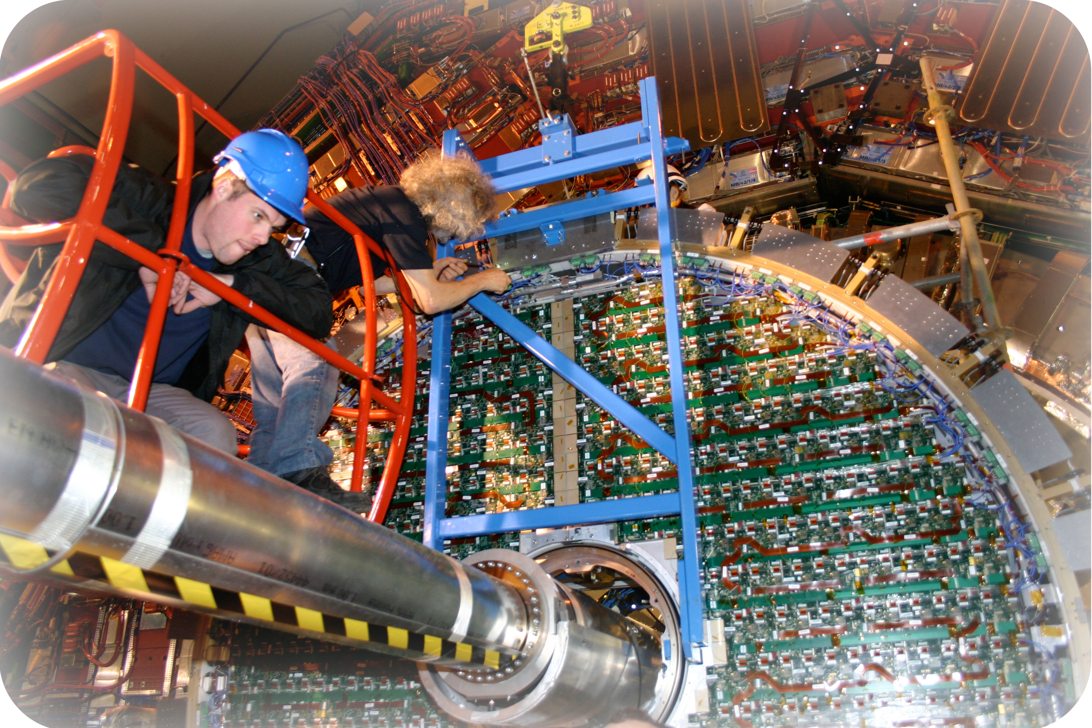
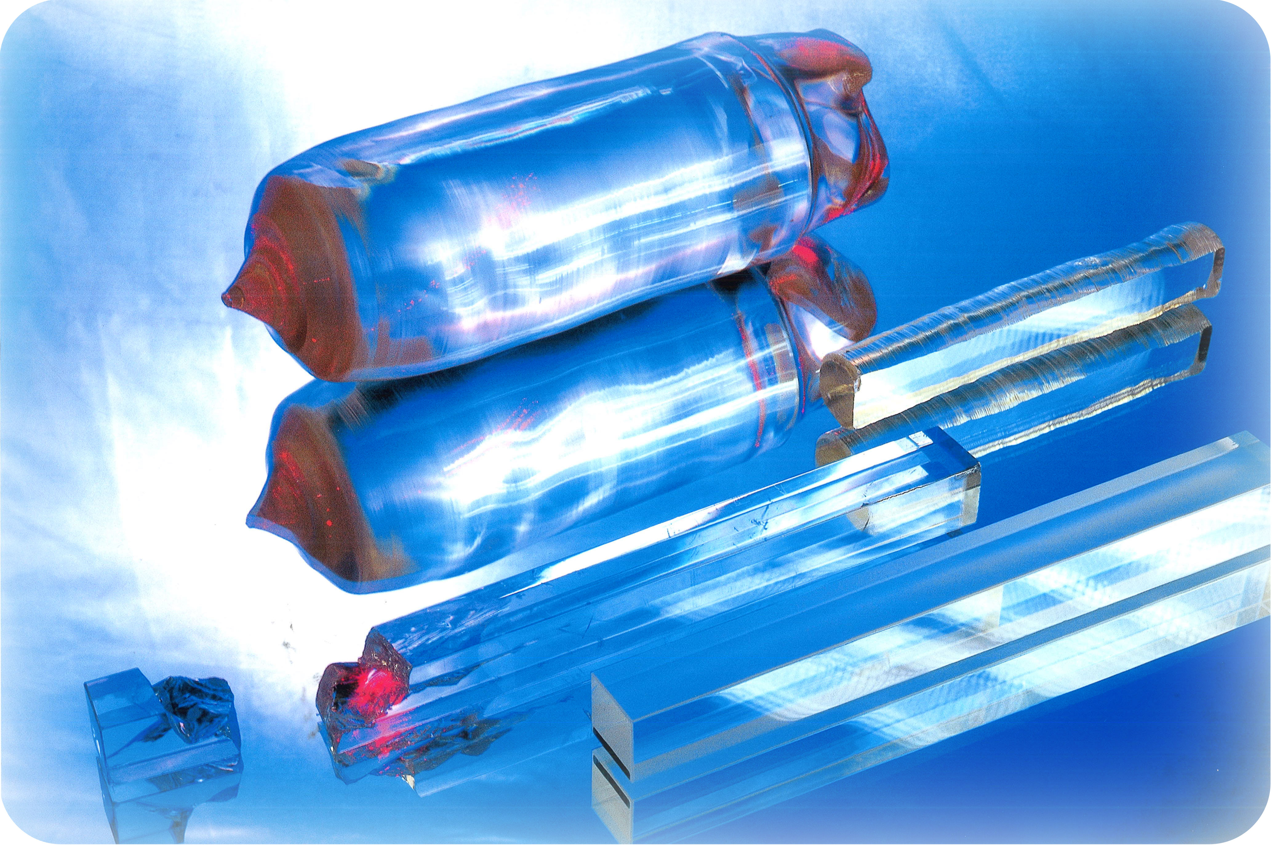
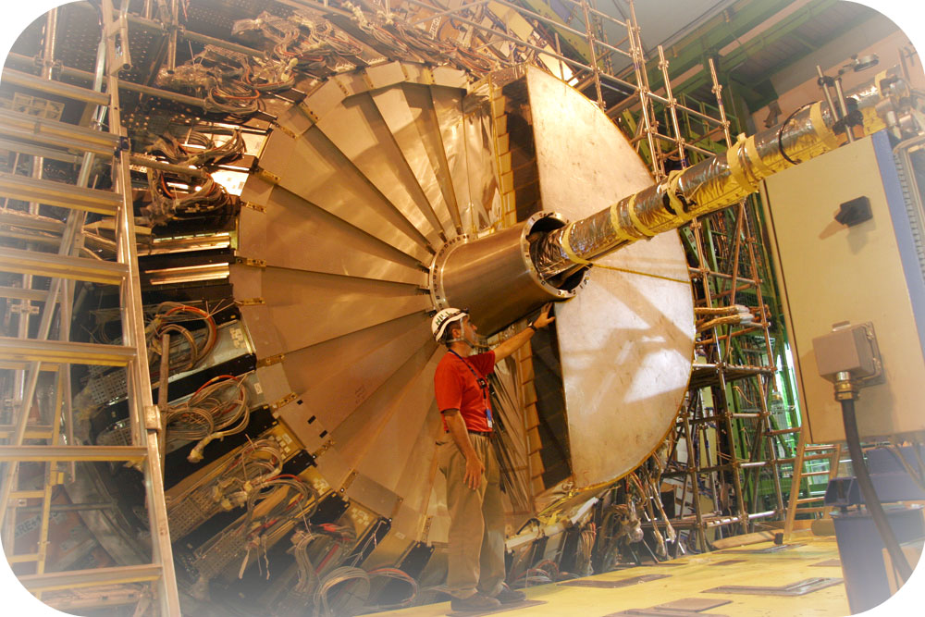
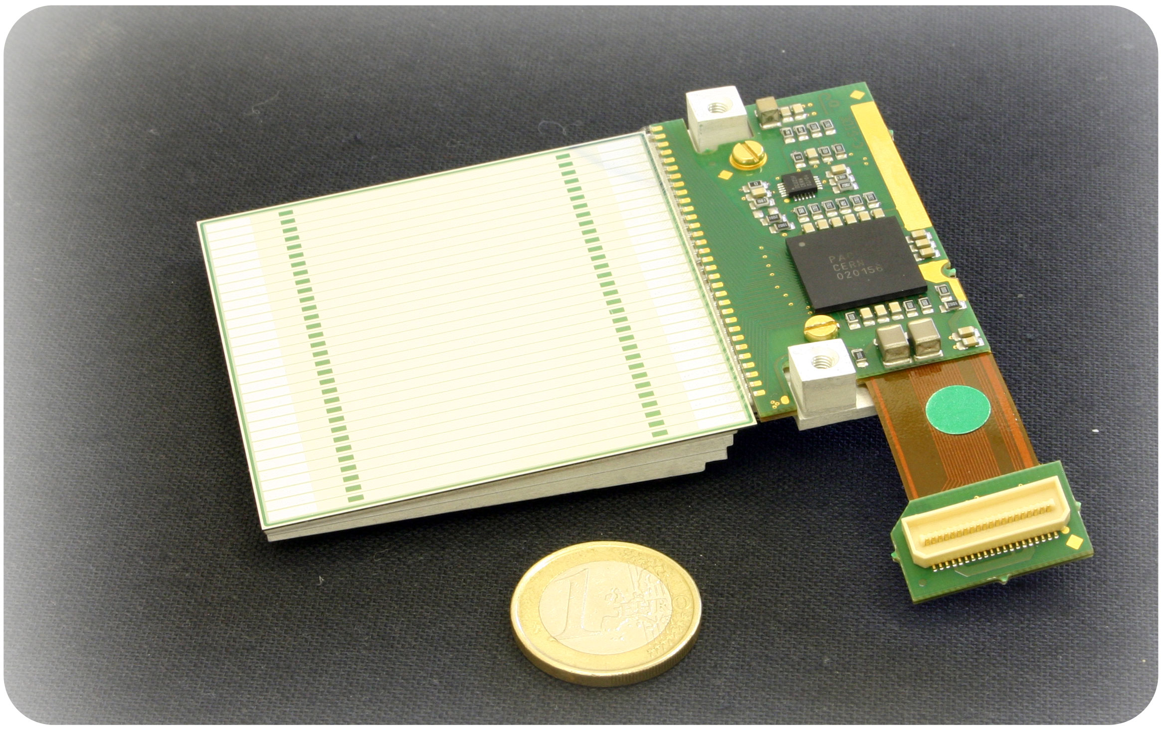
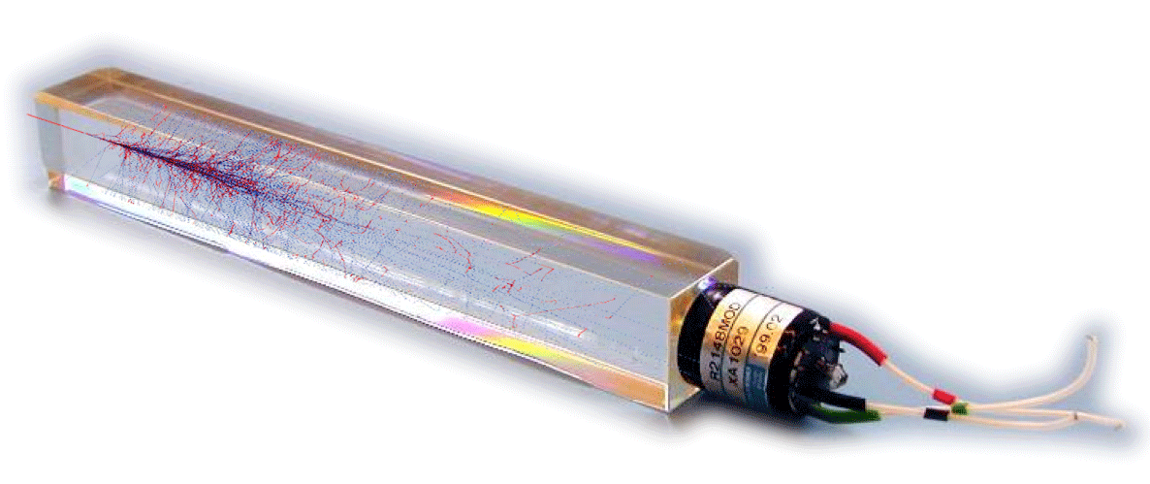
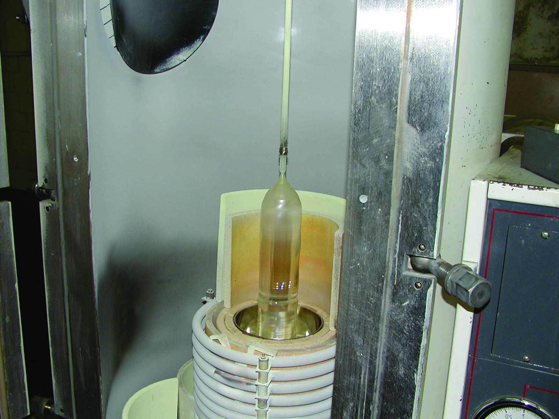
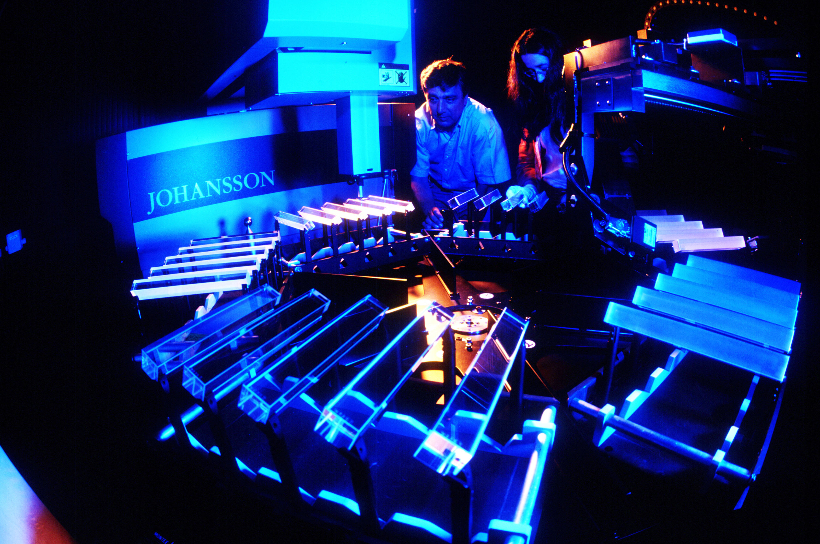
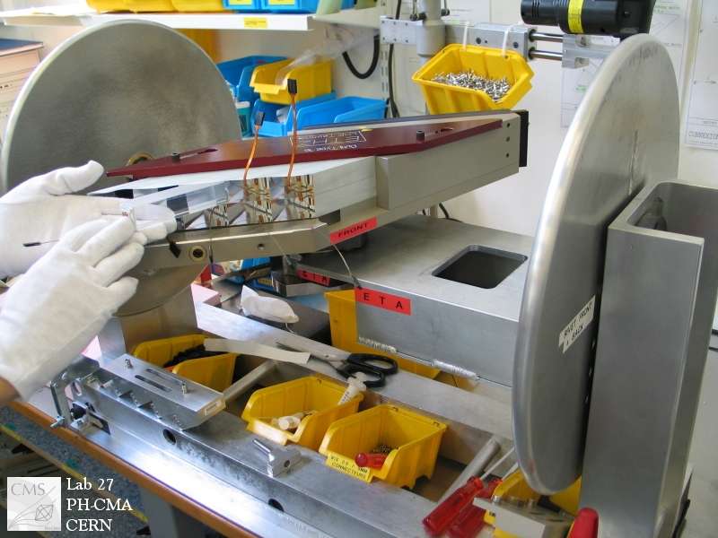
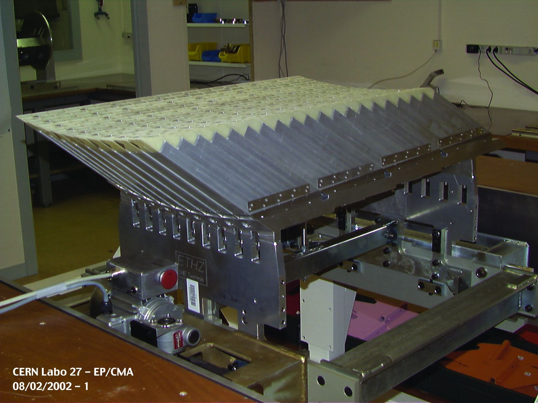
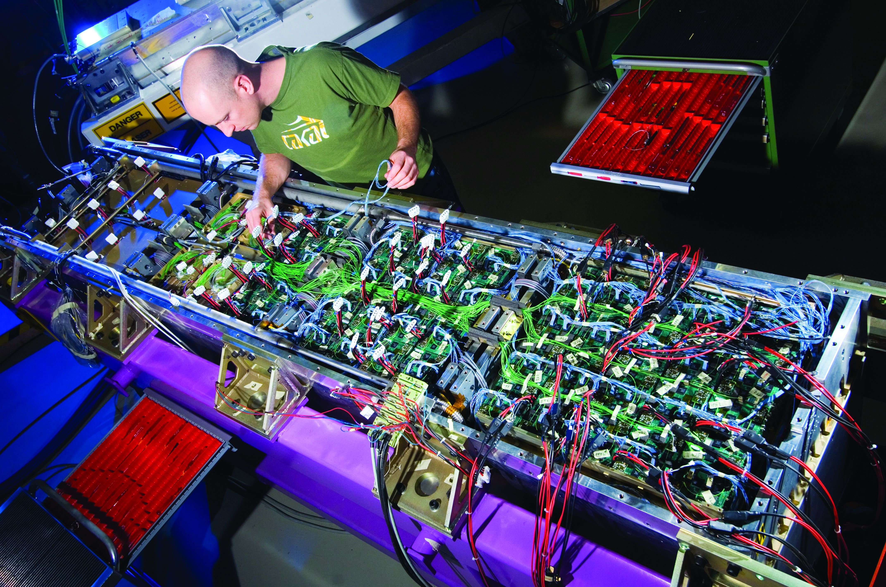
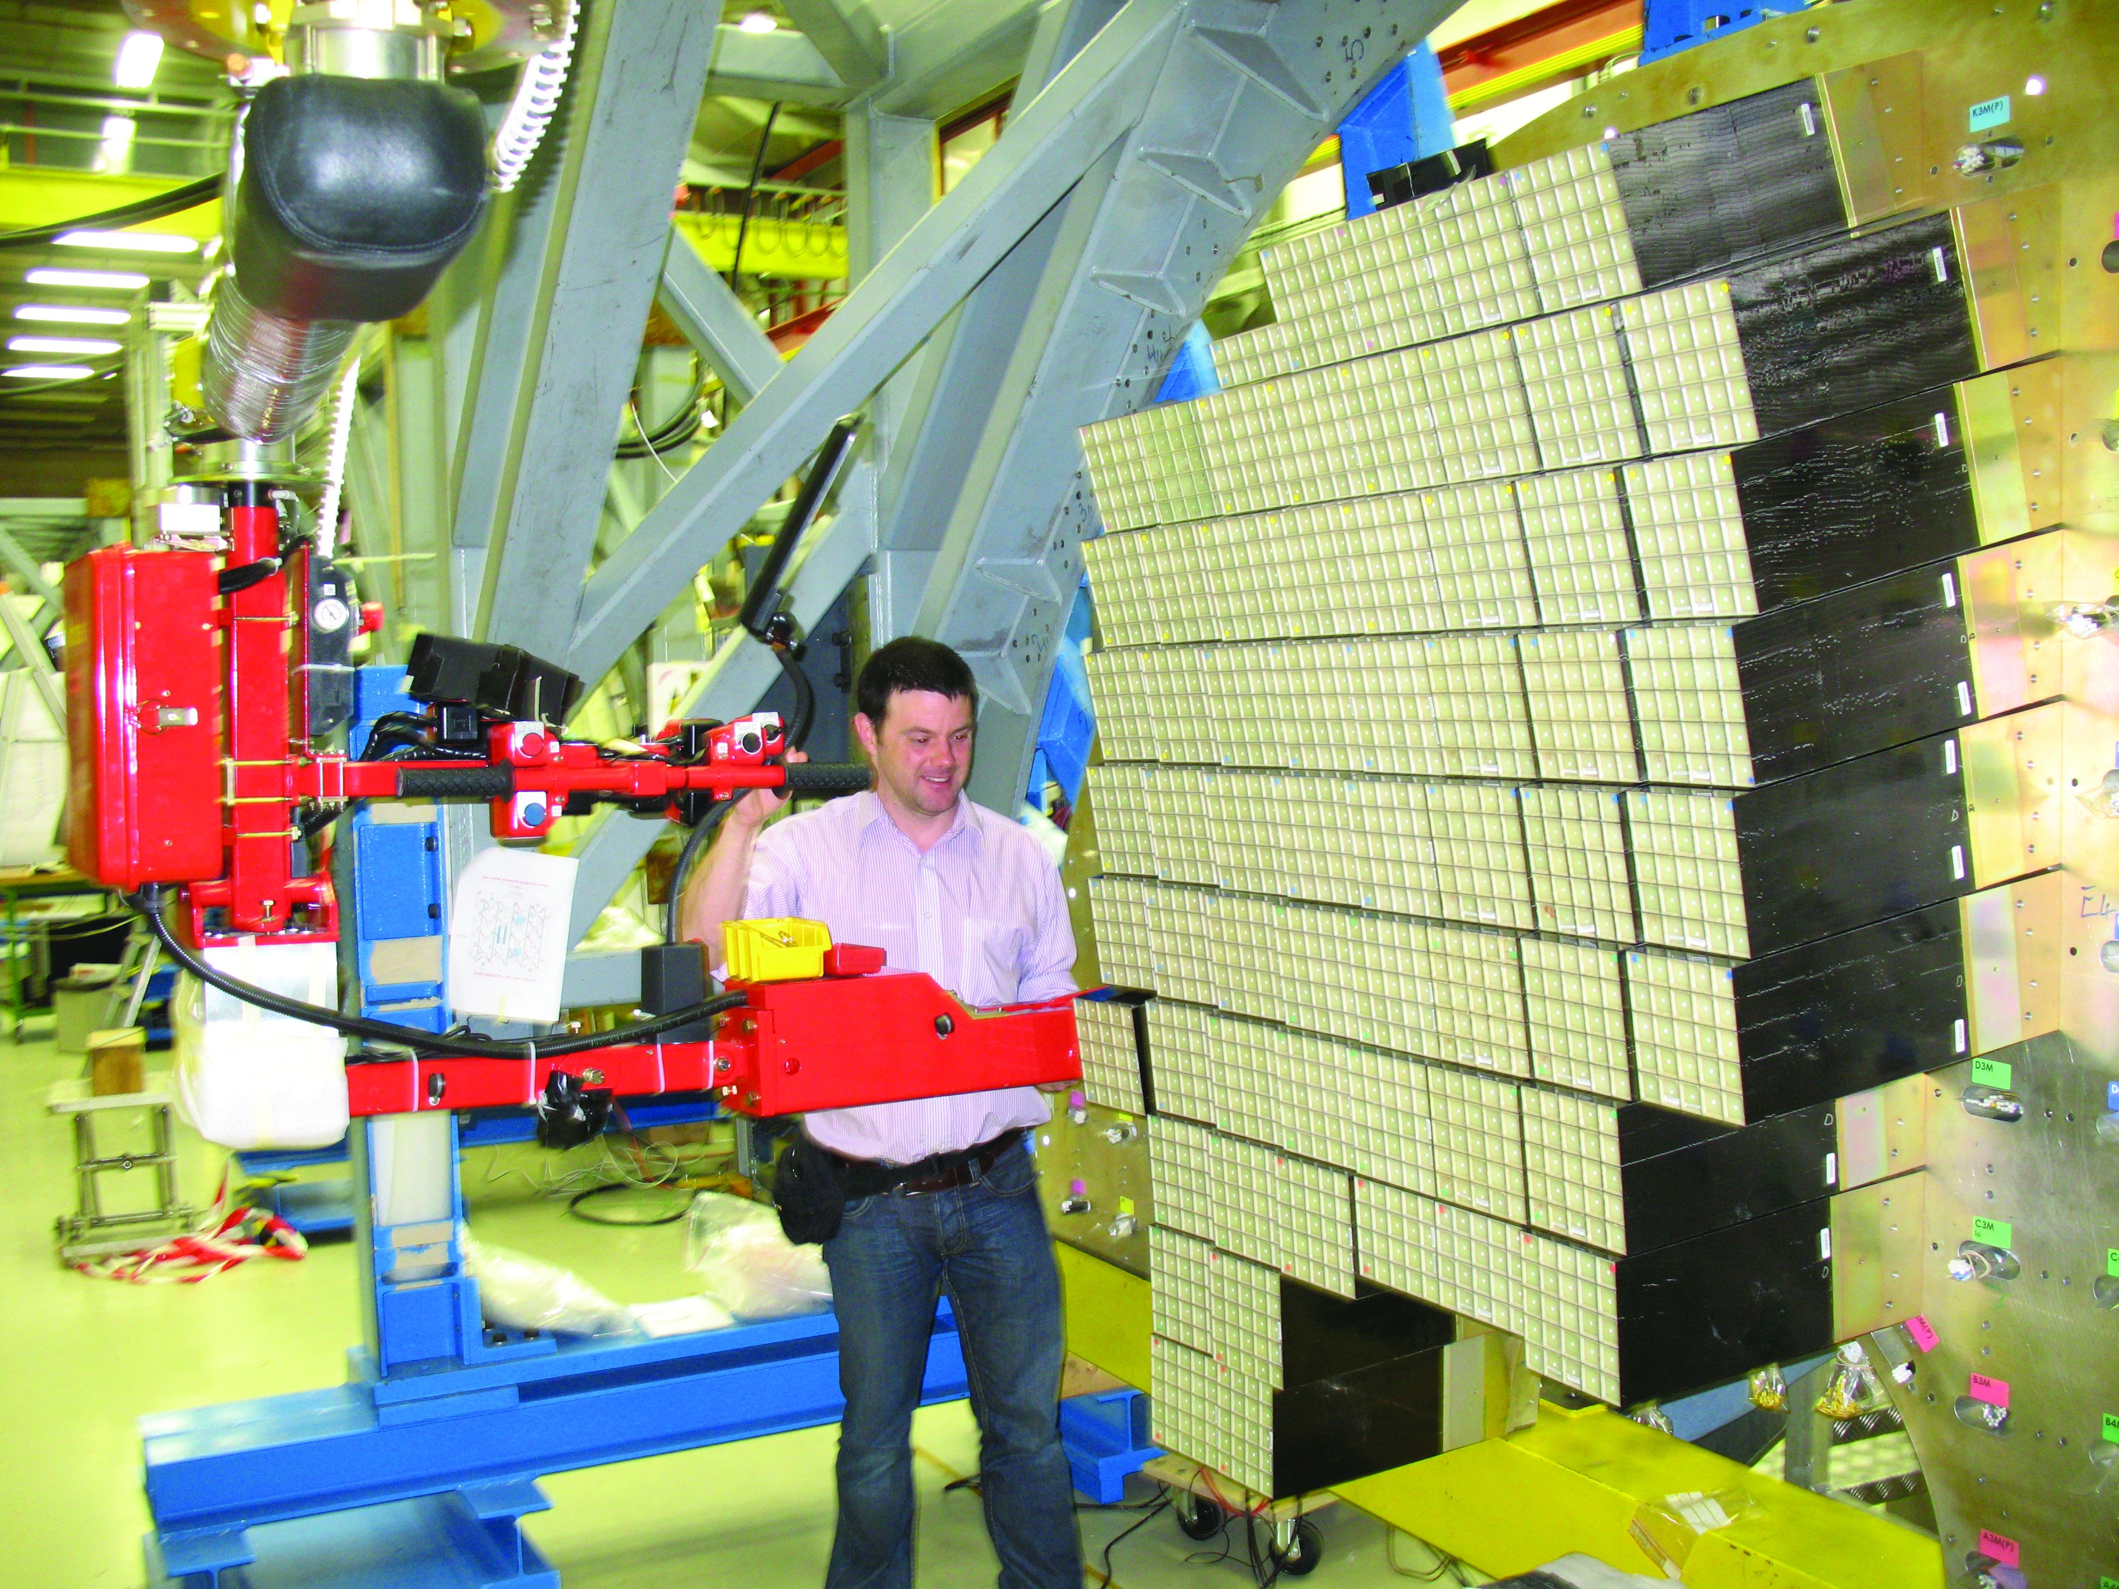
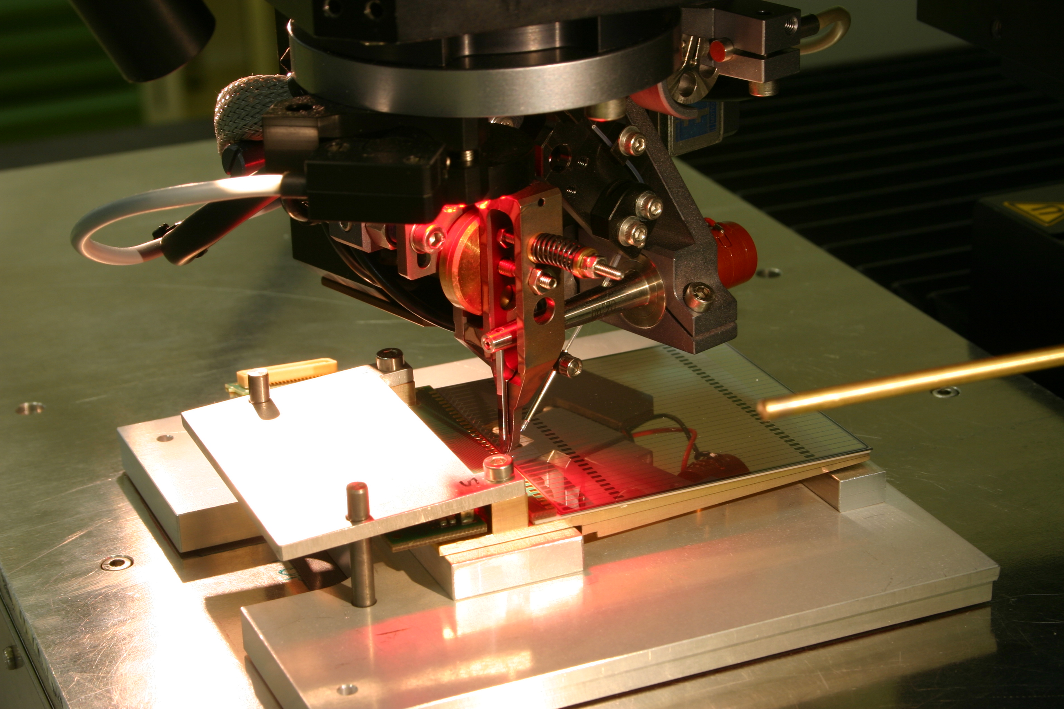
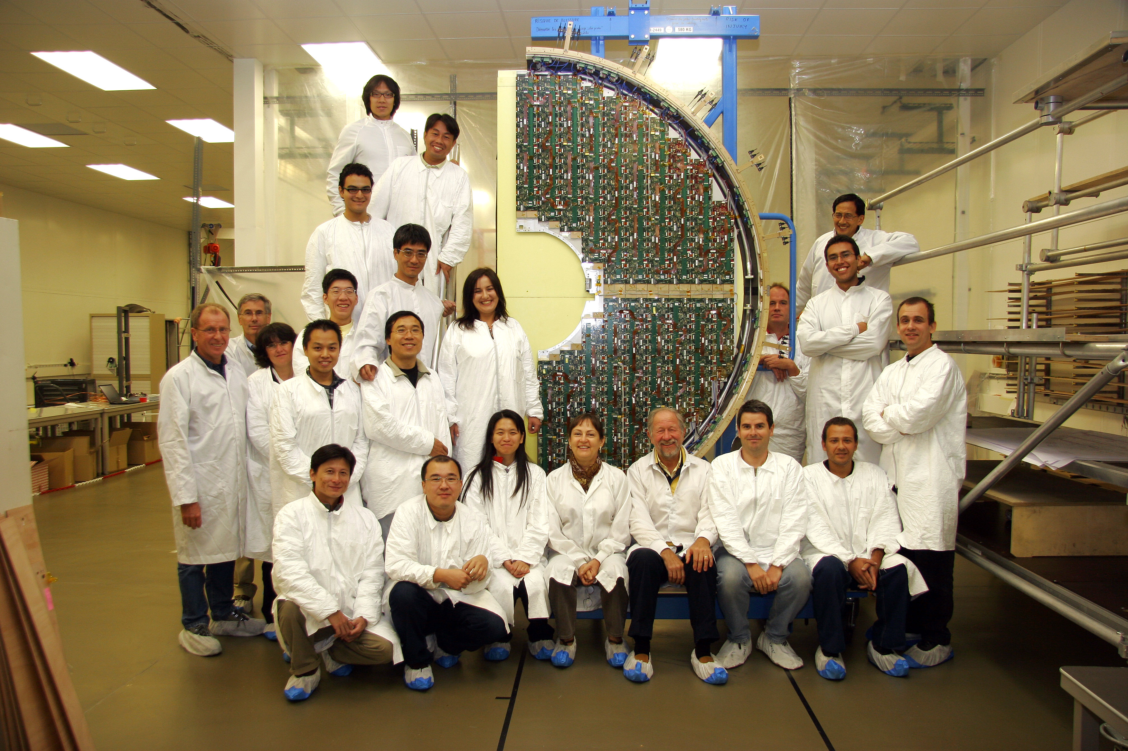
Electromagnetic Calorimeter
(ECAL)
Barrel ECAL
Endcap Preshower
Lead tungstate, before and after cutting and polishing
Endcap ECAL
Preshower silicon sensor
Electromagnetic Calorimeter (ECAL) 75848 crystals of lead tungstate (PbWO₄ – 86% metal but completely transparent) are used to measure precisely the energies of electrons and photons in the barrel and endcaps of CMS. In the barrel the crystals are 2.2 x 2.2 x 23 cm³ and in the endcaps they are 3 x 3 x 22 cm³. A preshower detector, based on 4288 silicon sensors, each measuring 6.1 x 6.1 x 0.03 cm³, helps particle identification in the endcaps.
How does the ECAL work?
How was the ECAL built?
Incoming electron/photon
1)
Growing a PbWO₄ crystal
takes about two days
2)
After cutting and polishing,
all crystals are characterized
PbWO₄ Crystal
Light detector
Incoming electrons and
photons release all of their energy in
the PbWO₄ crystals, producing a shower of particles as they do so. Light is also produced in the shower and measured by photodetectors (avalanche photodiodes – APDs – in the barrel; vacuum phototriodes – VPTs – in the endcaps) glued to the ends of the crystals; the amount of light is proportional to the energy of the electron/photon: more energy = more light.
3)
Photodetectors are glued
to the crystals and inserted
into support structures
4)
Up to 1700 crystals are grouped together
5)
Electronics, monitoring, safety and cooling systems are added
→ Ready for installation
5x5 groups of crystals being mounted on an endcap
6)
Silicon sensors for the
Preshower being wire-bonded
to readout electronics
7)
8)
A half-disc of the preshower ready for installation

